Slide 1
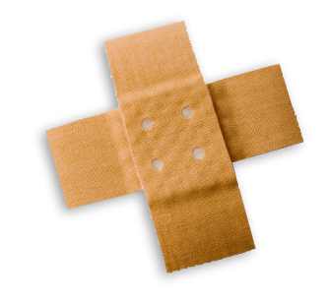
Basic First Aid for Medical Emergencies
BY :- SAILESH MAHAPATRA,
S.E.C.L., KORBA
SAILESH MAHAPATRA
Notes:
Slide Show Notes
When a serious injury occurs, you have to think and act quickly. Medical assistance may be only minutes away, but sometimes seconds count. What you do in those first few seconds and minutes can make the difference between life and death. Quick, calm, and correct action can make all the difference.
“First aid” is emergency care given to the sick or injured before medical personnel arrive. That’s why a knowledge of first aid and CPR (cardiopulmonary resuscitation) is so important. And that’s why you’re participating in this session today.
The purpose of this session is to provide you with a basic overview of first-aid techniques and priorities. It is not the same as a first-aid and CPR certification course. A certification course is much more detailed and offers you the opportunity to practice first-aid and CPR skills as well as to provide you with hours of classroom training.
We urge you to take a course and get certified. Taking a certification course will give you the full knowledge and confidence you need to use first-aid skills on the job, at home, and elsewhere in your community.
In the meantime, the information in this session can help you better handle medical emergencies when you are the first or only person on the scene.

Slide 2
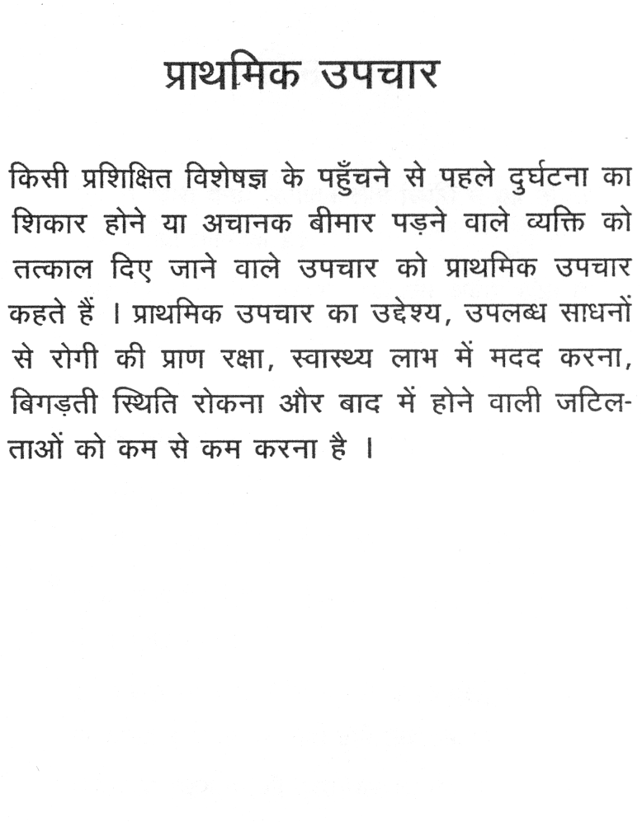
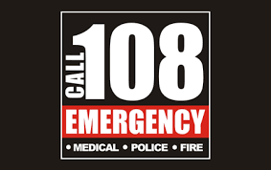
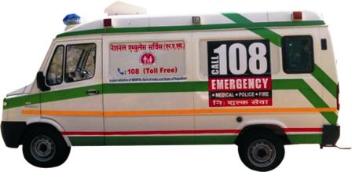
SAILESH MAHAPATRA

Slide 3
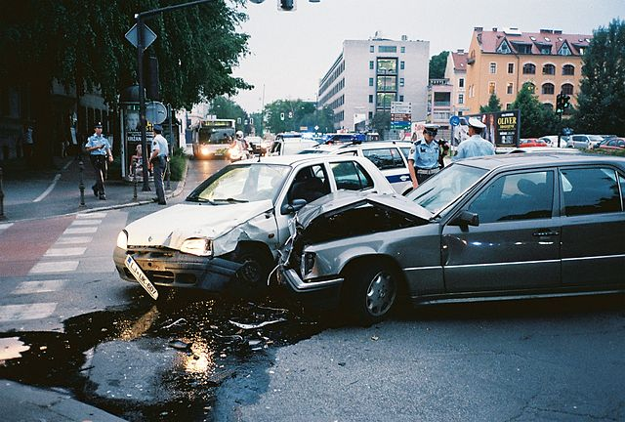
Exercise: incident management
Take a few minutes to discuss:
1) How would you manage this incident?
2) What dangers are present or could be present?
3) What should your first action be?
SAILESH MAHAPATRA
Notes:
*

Slide 4
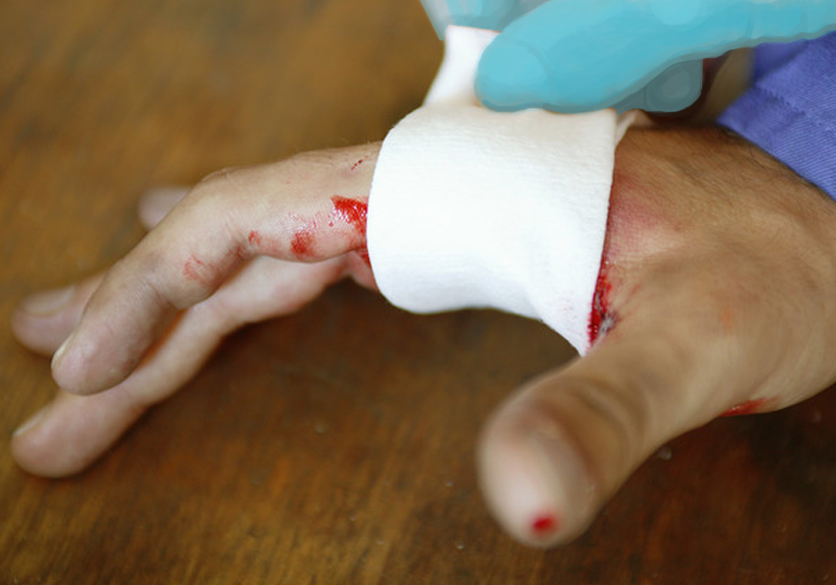
Bleeding
Stop the flow of blood
Wear gloves
Cover the wound
Apply pressure
SAILESH MAHAPATRA

Slide 5
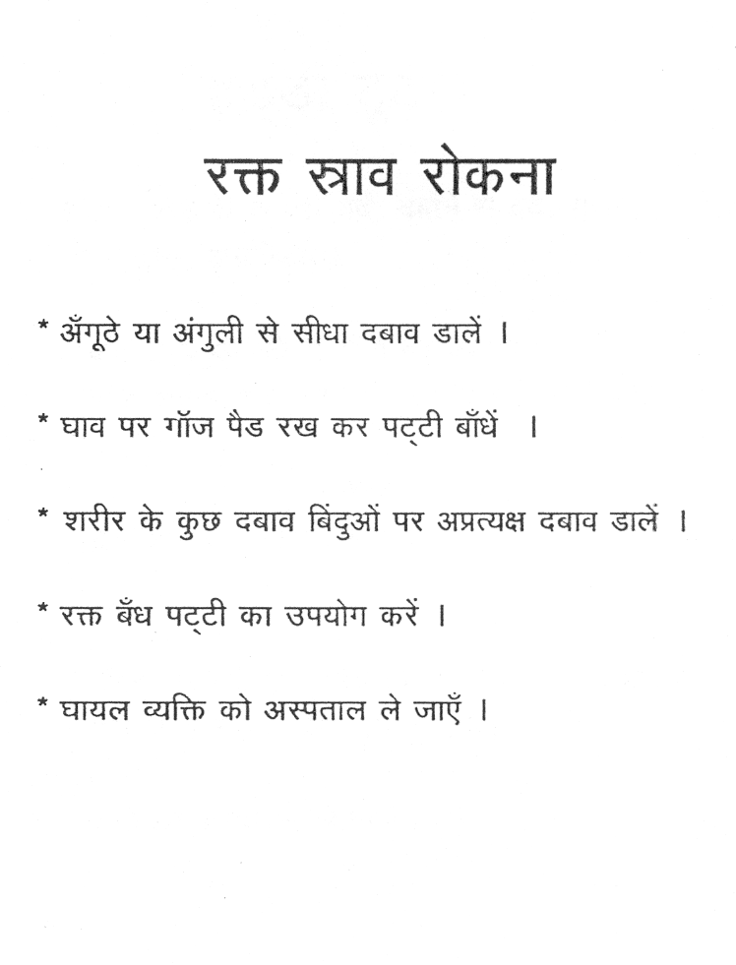
SAILESH MAHAPATRA

Slide 6

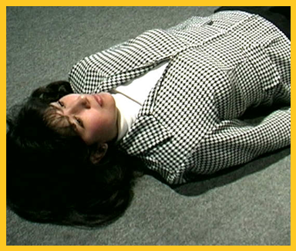
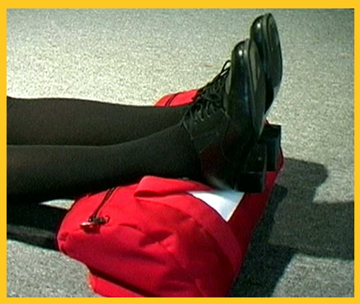
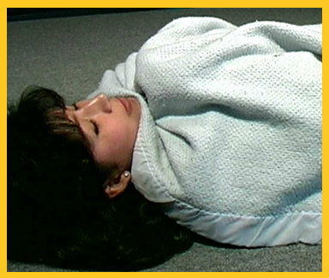

Shock
Lay the victim down
Cover
Raise feet
SAILESH MAHAPATRA
Notes:
Slide Show Notes
In cases where a person has lost a lot of blood, a condition known as shock can develop. Shock is the body’s way of reacting to severe injury. A person in shock may appear stunned or confused. To treat shock:
Lay the victim down,
Cover the victim to keep him or her warm, and
Raise the feet slightly above heart level.

Slide 7
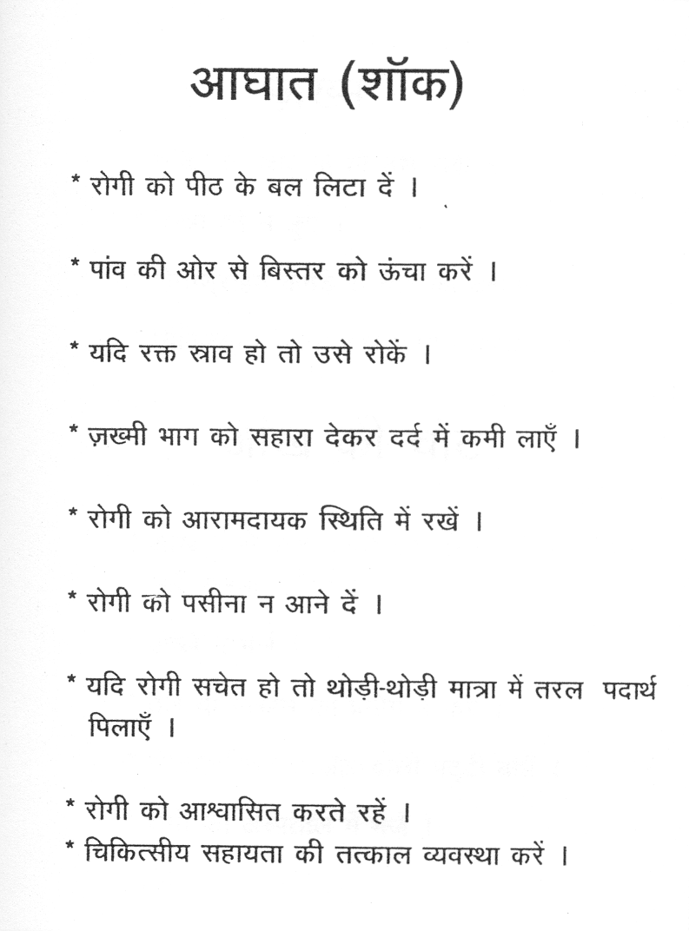
SAILESH MAHAPATRA

Slide 8
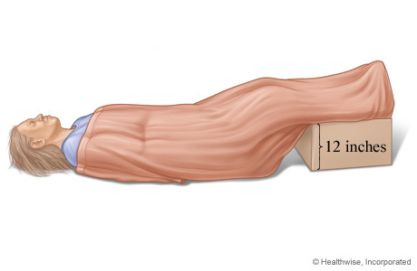
Photo: Treatment of shock
SAILESH MAHAPATRA
Notes:
*

Slide 9
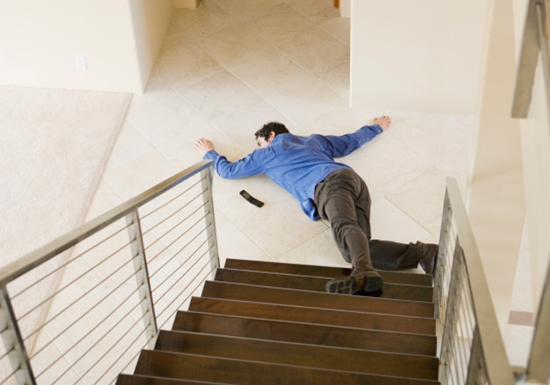
Broken Bones / FRACTURES
Look
Ask
Treat for shock
SAILESH MAHAPATRA
© Business & Legal Reports, Inc. 1110
Notes:
Slide Show Notes
The rule for treating people who may have broken bones is never to move them unless it’s necessary for their safety. Neck and back injuries are especially risky. The wrong move could cause paralysis or death. If you suspect broken bones, call for emergency medical assistance, and instruct the victim not to move.
Then look for swelling and deformity.
Ask the victim to rate the pain, explain how the injury happened, and if he or she can move the injured limb.
Treat for shock if the person shows symptoms.
If it seems that a person might have a broken bone, apply ice wrapped in a towel or cloth to the area, and keep the victim comfortable until help arrives.

Slide 10
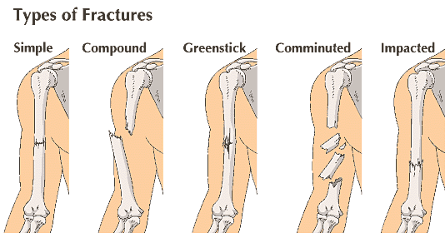
SAILESH MAHAPATRA

Slide 11
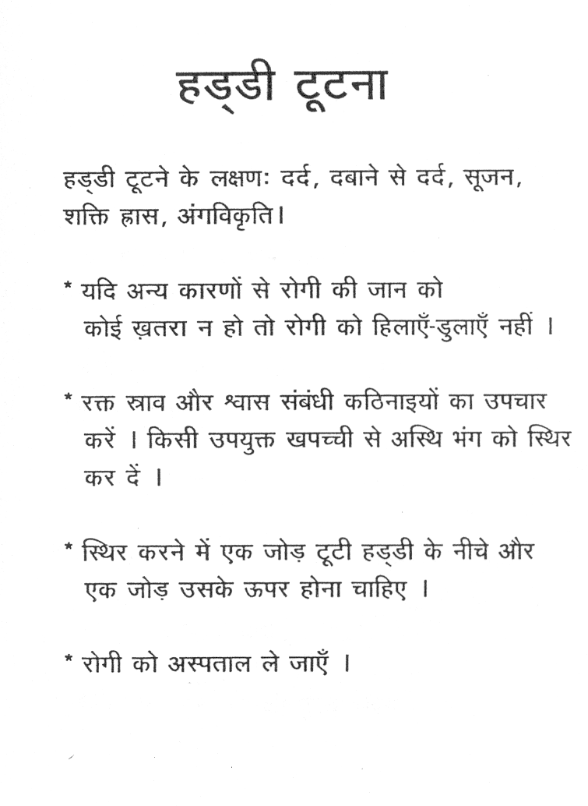
SAILESH MAHAPATRA

Slide 12

SAILESH MAHAPATRA

Slide 13
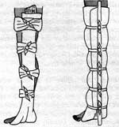
SAILESH MAHAPATRA

Slide 14
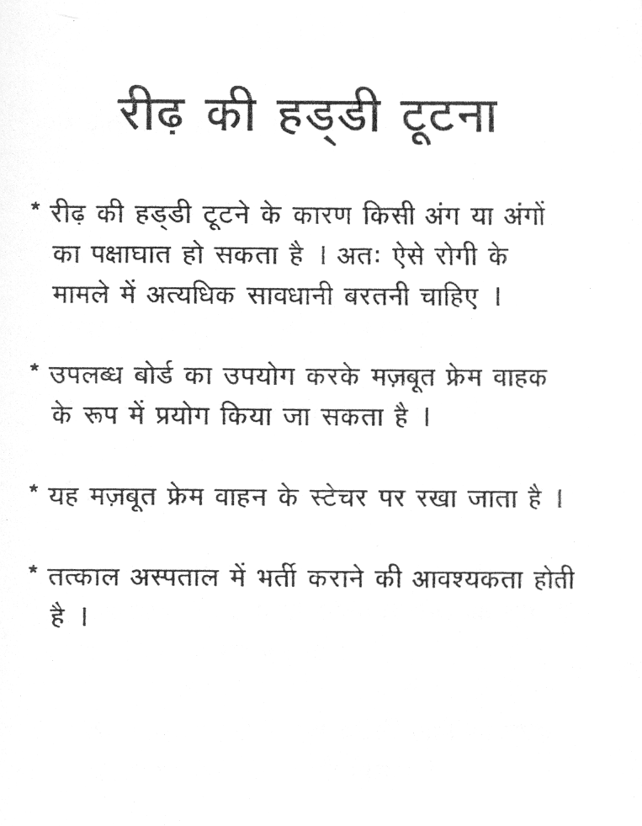

Slide 15

Cardio Pulmonary Resuscitation (CPR)
SAILESH MAHAPATRA
Notes:
*

Slide 16
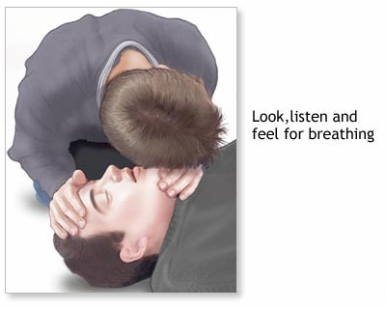
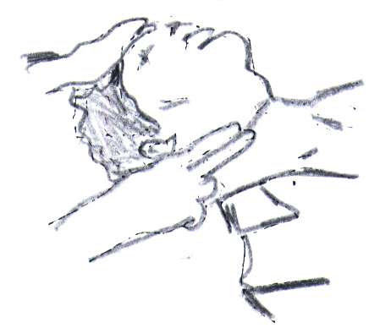
SAILESH MAHAPATRA

Slide 17
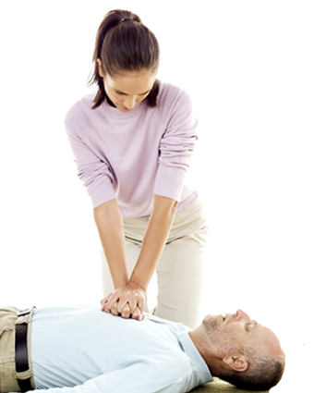
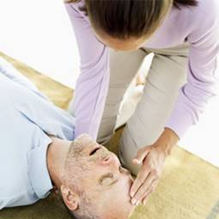
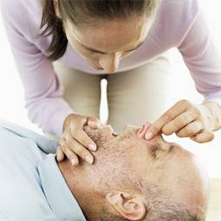
No Breathing
Administer CPR:
Lay the person on his or her back
Give chest compressions
Tilt head slightly
Breathe into the person’s mouth
Continue until EMS personnel arrive
SAILESH MAHAPATRA
Notes:
Slide Show Notes
Now let’s look at some specific medical emergencies. We’ll begin with no breathing. When a person is unconscious and not breathing, irreversible brain damage occurs within 3 minutes. You have to act very fast.
Someone trained in cardiopulmonary resuscitation, or CPR, should lay the person on his or her back while someone else calls 911. Loosen the clothes around the neck and make sure nothing is blocking the mouth or throat.
First, give 30 chest compressions by placing both hands in the center of the victim’s chest with one hand on top of the other and pressing down with the heel of your hand 1½ to 2 inches. Press quickly at a rate of about 100 compressions a minute.
Next, open the airway by tilting the head slightly and lifting under the chin. Do not move the victim’s head back if you suspect a neck injury.
Form a seal around the mouth and pinch the nose. Use a pocket mask if you are trained in its proper use. Breathe two slow breaths into the person’s mouth—enough to make the chest rise and fall. Then, continue chest compressions.
Once you begin CPR, continue until EMS personnel arrive.

Slide 18
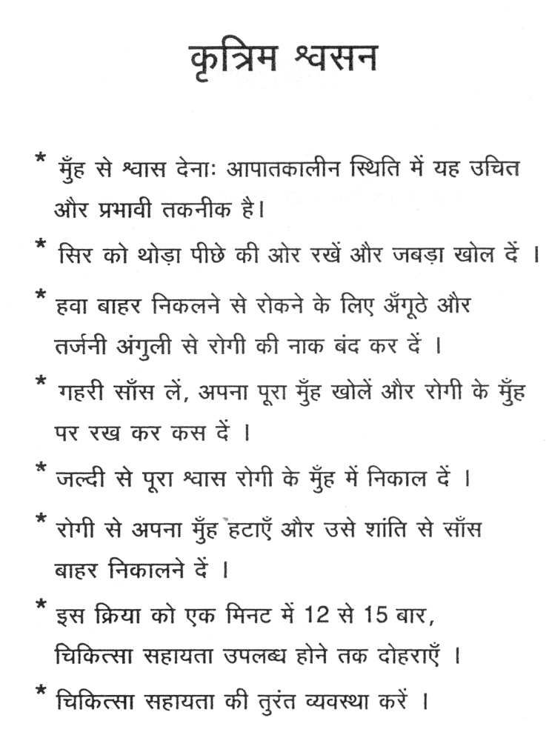
SAILESH MAHAPATRA

Slide 19
THANK YOU
SAILESH MAHAPATRA

